Slide 1

TNH-200-101-006 (Attachment)
CT Description
CT Process Flow and Evaporative Cooling
Problems in CT Water System
CT Water Treatment

Slide 2
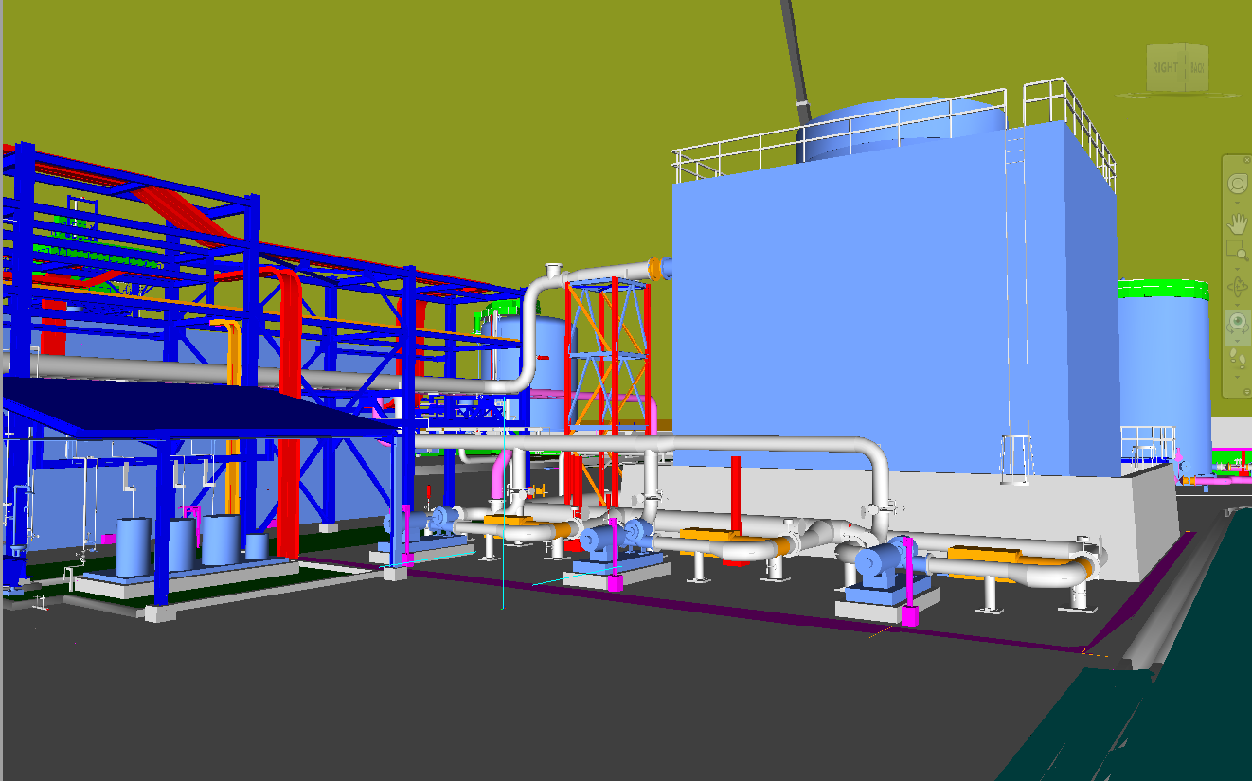
MS Cooling Tower
CT - Fan
Induced Draft CT
CT – Chemical Dosing System
Cooling Water Pumps

Slide 3

Cooling Tower System
A cooling tower is a heat rejection device used to transfer process waste heat to the atmosphere mainly through evaporative cooling
It is mainly used for lowering the temperature of cooling water return from the heat exchange equipment in the process area
This is an induced draft type cooling tower system which uses cooling fan installed at the top of the tower to draw-in atmospheric air and contact with the water to be cooled

Slide 4
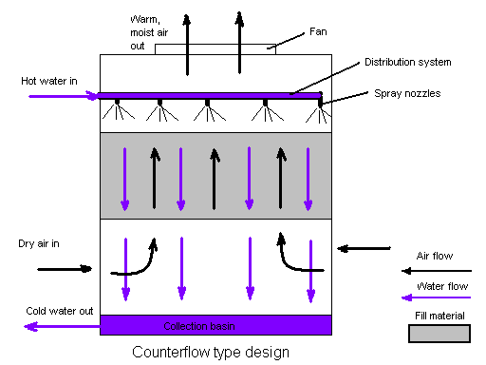
Cooling Tower Process Flow

Slide 5
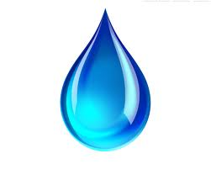
Evaporative Cooling in CT
Atmospheric air comes in contact with the surface of water droplet
Partial equalization and evaporation water causes cooling of water droplet
Heat from evaporation and evaporated water is carried upward by the warm humid air
Warm Humid Air
mΔHvap
Atmospheric Air

Slide 6
Cooling Tower Parts
Framework and Casing
Water Distributor and Spray
Heat Exchange Surfaces – Filling
Collecting Basin
Cooling Tower Fan
Drift Eliminators

Slide 7
Cooling Tower Technical Data
  Total Circulating Water Flow: 2,000 m³/H
  Hot (Inlet) Water Temperature: 42°C
  Cold (Outlet) Water Temperature: 32°C
  Wet Bulb Temperature (inlet): 29°C
  Relative Humidity: 85%
  Drift loss (% of circulating flow): 0.005 or less
  Evaporation loss % (at design): 1.48 (< 1.5)

Slide 8
Problems on CT Water System
Problems | Effects
Corrosion Due to increase of corrosive elements such as chlorides and sulfates and the existence of oxygen Scaling Supersaturation of dissolved salts due to evaporation in CT Slime - Due to presence of bacteria, algae and fungi in the cooling water | Heat transfer efficiency drop Clogging of HX Increase pump pressure Drop of water flow Dirty appearance Accumulation of sludge

Slide 9
Corrosion in CT System Pipe
Corrosion is the reduction-oxidation reaction of Fe, H2O and O2 forming rust
2Fe(OH)₃
4
Anode (1): Fe → Fe²⁺ + 2e⁻
Cathode (2): ½ O₂ + H₂O + 2e⁻ → 2OH⁻
Reaction (3): Fe²⁺ + 2 OH⁻ → Fe(OH)₂
Reaction (4):
2Fe(OH)₂ + ½ O₂ + H₂O → 2Fe(OH)₃ or
Fe₂O₃.3H₂O
H₂O
½ O₂
2Fe(OH)₂
3
2 H₂O
2Fe²⁺
4OH⁻
O₂
1
2
Carbon Steel
4e⁻

Slide 10

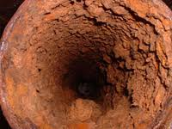
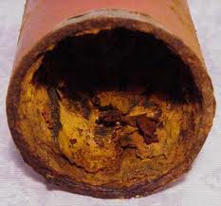
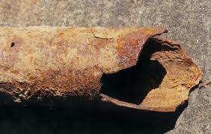
Corrosion in CT System Pipe

Slide 11
Corrosion Treatment in MS CT
Corrosion treatment in MS CT uses precipitating film agents that forms protective layer over the metal
Precipitating film compounds – Polyphosphates, ortrhophosphates, phosphonates and zinc salts
Characteristics:
Porous and thick (200 – 500 Ǻ)
Forms iron oxides/phosphates and calcium/zinc phosphates protective layer
Good corrosion protection
Film grows to thick to become scales if not controlled
Precipitating Film Layer
Carbon Steel

Slide 12
Scales in CT System Pipe
Scales are formed when dissolved salts in the cooling water are supersaturated due to evaporation loss in CT
Growth of nuclei into micro-crystal
Growth into macro-crystal (scales)
Super-saturation
Crystal Growth
Nucleation
Typical components of scales
Calcium carbonate
Calcium and zinc phosphate
Silica and magnesium silicates
Calcium sulfates

Slide 13
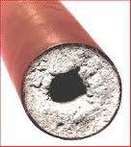
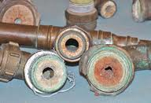
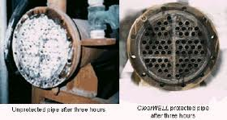
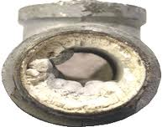
Scales in CT System Pipe

Slide 14
Scales Treatment in MS CT
Scales treatment in MS CT uses scale inhibitor/ dispersant that prevents aggregation of crystals and distorts crystal formation
Scale inhibitors – polymer compounds
Growth of nuclei into micro-crystal
Growth into macro-crystal (scales)
Super-saturation
Crystal Growth
Nucleation
Scale Inhibitor Actions
Inhibition of precipitate formation
Crystal Distortion
Dispersion

Slide 15
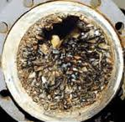
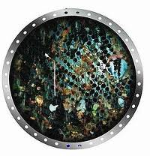
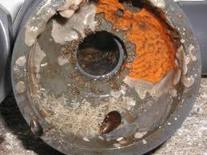
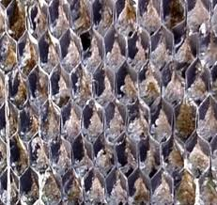
Biofouling in CT System Pipe
Biofouling is formed due to the growth (biomass) of bacteria, algae, fungi and other microorganism found in water

Slide 16
Biofouling Treatment in MS CT
Biofouling treatment in MS CT uses biocides to discourage growth of microorganism in water
Biocides are either oxidizing or non-oxidizing type
Oxidizing biocides; Cl₂ gas, NaOCl, Ca(ClO)₂, NaBr, etc
Non-oxidizing biocides; organic nitrogen-sulfur compounds, quaternary ammonium and phosphonium salts, glutaraldehyde, nitrogenous compounds, etc.

Slide 17
Cooling Tower Water Treatment
Initial Treatment / Passivation
- water treatment before the start of heat load
- to ensure formation of protective coating in cooling water system
Maintenance Treatment
water treatment during the start of heat load
maintain the quality of cooling water to prevent corrosion, scaling and fouling in the cooling water system

Slide 18
Cooling Tower Passivation
Addition of corrosion inhibitor and scale inhibitor before the start of heat load
Chemicals Injected
KURITA P-3700 (polyphosphate compound)
KURITA S-6000 (zinc chloride compound)
KURITA T-8800 (organic polymer)
Passivation period last for 24 – 48 hours

Slide 19
CT Maintenance Treatment
Corrosion Inhibitor – KURITA S-7653B (azole, zinc and phosphate compounds)
Scale Inhibitor – KURITA T-8800 (organic polymer)
Primary Biocide – Hypochlorite (NaOCL)
Secondary Biocide – KURITA F-5100 (azole and isothiazolinone compounds)
Sulfuric Acid (98% H2SO4)

Slide 20
Cooling Water Control Range
  pH: 7.0 – 9.0
  Electrical Conductivity: < 2000 µS/cm
  M-Alkalinity: < 400 mg CaCO₃/L
  Calcium Hardness: 50 – 250 mg CaCO3/L
  Chloride: < 200 mg Cl/L
  Turbidity: < 20 NTU
  Total Phosphate: 5.0 – 10.0 mg PO₄/L
  Zinc: 1.0 – 2.0 mg Zn / L
  Free Chlorine: 0.2 – 0.5 mg free Cl/L
  Cycle Concentration: < 4

Slide 21
Summary
MS CT is an Induced Draft Type which uses evaporative cooling to lower the temperature of cooling water return
MS CT Water System requires passivation and maintenance treatment to prevent corrosion, scaling and biofouling in the pipelines

Slide 22
END

